Slide 1
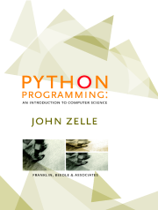
Python Programming:
An Introduction to
Computer Science
Chapter 13
Algorithm Design and Recursion

Slide 2
Objectives
To understand the basic techniques for analyzing the efficiency of algorithms.
To know what searching is and understand the algorithms for linear and binary search.
To understand the basic principles of recursive definitions and functions and be able to write simple recursive functions.

Slide 3
Objectives
To understand sorting in depth and know the algorithms for selection sort and merge sort.
To appreciate how the analysis of algorithms can demonstrate that some problems are intractable and others are unsolvable.

Slide 4
Searching
Searching is the process of looking for a particular value in a collection.
For example, a program that maintains a membership list for a club might need to look up information for a particular member – this involves some sort of search process.

Slide 5
A simple Searching Problem
Here is the specification of a simple searching function:
def search(x, nums):
# nums is a list of numbers and x is a number
# Returns the position in the list where x occurs
# or -1 if x is not in the list.
Here are some sample interactions:
>>> search(4, [3, 1, 4, 2, 5])
2
>>> search(7, [3, 1, 4, 2, 5])
-1

Slide 6
A Simple Searching Problem
In the first example, the function returns the index where 4 appears in the list.
In the second example, the return value -1 indicates that 7 is not in the list.
Python includes a number of built-in search-related methods!

Slide 7
A Simple Searching Problem
We can test to see if a value appears in a sequence using in.
if x in nums:
# do something
If we want to know the position of x in a list, the index method can be used.
>>> nums = [3, 1, 4, 2, 5]
>>> nums.index(4)
2

Slide 8
A Simple Searching Problem
The only difference between our search function and index is that index raises an exception if the target value does not appear in the list.
We could implement search using index by simply catching the exception and returning -1 for that case.

Slide 9
A Simple Searching Problem
def search(x, nums):
try:
return nums.index(x)
except:
return -1
Sure, this will work, but we are really interested in the algorithm used to actually search the list in Python!

Slide 10
Strategy 1: Linear Search
Pretend you’re the computer, and you were given a page full of randomly ordered numbers and were asked whether 13 was in the list.
How would you do it?
Would you start at the top of the list, scanning downward, comparing each number to 13? If you saw it, you could tell me it was in the list. If you had scanned the whole list and not seen it, you could tell me it wasn’t there.

Slide 11
Strategy 1: Linear Search
This strategy is called a linear search, where you search through the list of items one by one until the target value is found.
def search(x, nums):
for i in range(len(nums)):
if nums[i] == x: # item found, return the index value
return i
return -1 # loop finished, item was not in list
This algorithm wasn’t hard to develop, and works well for modest-sized lists.

Slide 12
Strategy 1: Linear Search
The Python in and index operations both implement linear searching algorithms.
If the collection of data is very large, it makes sense to organize the data somehow so that each data value doesn’t need to be examined.

Slide 13
Strategy 1: Linear Search
If the data is sorted in ascending order (lowest to highest), we can skip checking some of the data.
As soon as a value is encountered that is greater than the target value, the linear search can be stopped without looking at the rest of the data.
On average, this will save us about half the work.

Slide 14
Strategy 2: Binary Search
If the data is sorted, there is an even better searching strategy – one you probably already know!
Have you ever played the number guessing game, where I pick a number between 1 and 100 and you try to guess it? Each time you guess, I’ll tell you whether your guess is correct, too high, or too low. What strategy do you use?

Slide 15
Strategy 2: Binary Search
Young children might simply guess numbers at random.
Older children may be more systematic, using a linear search of 1, 2, 3, 4, … until the value is found.
Most adults will first guess 50. If told the value is higher, it is in the range 51-100. The next logical guess is 75.

Slide 16
Strategy 2: Binary Search
Each time we guess the middle of the remaining numbers to try to narrow down the range.
This strategy is called binary search.
Binary means two, and at each step we are diving the remaining group of numbers into two parts.

Slide 17
Strategy 2: Binary Search
We can use the same approach in our binary search algorithm! We can use two variables to keep track of the endpoints of the range in the sorted list where the number could be.
Since the target could be anywhere in the list, initially low is set to the first location in the list, and high is set to the last.

Slide 18
Strategy 2: Binary Search
The heart of the algorithm is a loop that looks at the middle element of the range, comparing it to the value x.
If x is smaller than the middle item, high is moved so that the search is confined to the lower half.
If x is larger than the middle item, low is moved to narrow the search to the upper half.

Slide 19
Strategy 2: Binary Search
The loop terminates when either
  x is found
  There are no more places to look
  (low > high)

Slide 20
Strategy 2: Binary Search
def search(x, nums):
low = 0
high = len(nums) - 1
while low <= high: # There is still a range to search
mid = (low + high)/2 # Position of middle item
item = nums[mid]
if x == item: # Found it! Return the index
return mid
elif x < item: # x is in lower half of range
high = mid - 1 # move top marker down
else: # x is in upper half of range
low = mid + 1 # move bottom marker up
return -1 # No range left to search,
# x is not there

Slide 21
Comparing Algorithms
Which search algorithm is better, linear or binary?
  The linear search is easier to understand and implement
  The binary search is more efficient since it doesn’t need to look at each element in the list
Intuitively, we might expect the linear search to work better for small lists, and binary search for longer lists. But how can we be sure?

Slide 22
Comparing Algorithms
One way to conduct the test would be to code up the algorithms and try them on varying sized lists, noting the runtime.
  Linear search is generally faster for lists of length 10 or less
  There was little difference for lists of 10-1000
  Binary search is best for 1000+ (for one million list elements, binary search averaged .0003 seconds while linear search averaged 2.5 second)

Slide 23
Comparing Algorithms
While interesting, can we guarantee that these empirical results are not dependent on the type of computer they were conducted on, the amount of memory in the computer, the speed of the computer, etc.?
We could abstractly reason about the algorithms to determine how efficient they are. We can assume that the algorithm with the fewest number of “steps” is more efficient.

Slide 24
Comparing Algorithms
How do we count the number of “steps”?
Computer scientists attack these problems by analyzing the number of steps that an algorithm will take relative to the size or difficulty of the specific problem instance being solved.

Slide 25
Comparing Algorithms
For searching, the difficulty is determined by the size of the collection – it takes more steps to find a number in a collection of a million numbers than it does in a collection of 10 numbers.
How many steps are needed to find a value in a list of size n?
In particular, what happens as n gets very large?

Slide 26
Comparing Algorithms
Let’s consider linear search.
  For a list of 10 items, the most work we might have to do is to look at each item in turn – looping at most 10 times.
  For a list twice as large, we would loop at most 20 times.
  For a list three times as large, we would loop at most 30 times!
The amount of time required is linearly related to the size of the list, n. This is what computer scientists call a linear time algorithm.

Slide 27
Comparing Algorithms
Now, let’s consider binary search.
  Suppose the list has 16 items. Each time through the loop, half the items are removed. After one loop, 8 items remain.
  After two loops, 4 items remain.
  After three loops, 2 items remain
  After four loops, 1 item remains.
If a binary search loops i times, it can find a single value in a list of size 2^{i}.

Slide 28
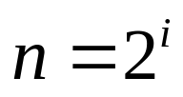
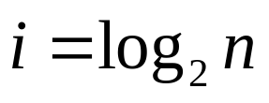
Comparing Algorithms
To determine how many items are examined in a list of size n, we need to solve for i, or .
Binary search is an example of a log time algorithm – the amount of time it takes to solve one of these problems grows as the log of the problem size.

Slide 29
Comparing Algorithms
This logarithmic property can be very powerful!
Suppose you have the New York City phone book with 12 million names. You could walk up to a New Yorker and, assuming they are listed in the phone book, make them this proposition: “I’m going to try guessing your name. Each time I guess a name, you tell me if your name comes alphabetically before or after the name I guess.” How many guesses will you need?

Slide 30
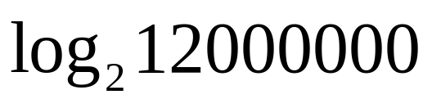
Comparing Algorithms
Our analysis shows us the answer to this question is .
We can guess the name of the New Yorker in 24 guesses! By comparison, using the linear search we would need to make, on average, 6,000,000 guesses!

Slide 31
Comparing Algorithms
Earlier, we mentioned that Python uses linear search in its built-in searching methods. We doesn’t it use binary search?
  Binary search requires the data to be sorted
  If the data is unsorted, it must be sorted first!

Slide 32
Recursive Problem-Solving
The basic idea between the binary search algorithm was to successfully divide the problem in half.
This technique is known as a divide and conquer approach.
Divide and conquer divides the original problem into subproblems that are smaller versions of the original problem.

Slide 33
Recursive Problem-Solving
In the binary search, the initial range is the entire list. We look at the middle element… if it is the target, we’re done. Otherwise, we continue by performing a binary search on either the top half or bottom half of the list.

Slide 34
Recursive Problem-Solving
Algorithm: binarySearch – search for x in nums[low]…nums[high]
mid = (low + high) /2
if low > high
x is not in nums
elsif x < nums[mid]
perform binary search for x in nums[low]…nums[mid-1]
else
perform binary search for x in nums[mid+1]…nums[high]
This version has no loop, and seems to refer to itself! What’s going on??

Slide 35
Recursive Definitions
A description of something that refers to itself is called a recursive definition.
In the last example, the binary search algorithm uses its own description – a “call” to binary search “recurs” inside of the definition – hence the label “recursive definition.”

Slide 36

Recursive Definitions
Have you had a teacher tell you that you can’t use a word in its own definition? This is a circular definition.
In mathematics, recursion is frequently used. The most common example is the factorial:
For example, 5! = 5(4)(3)(2)(1), or
5! = 5(4!)

Slide 37
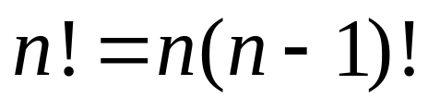
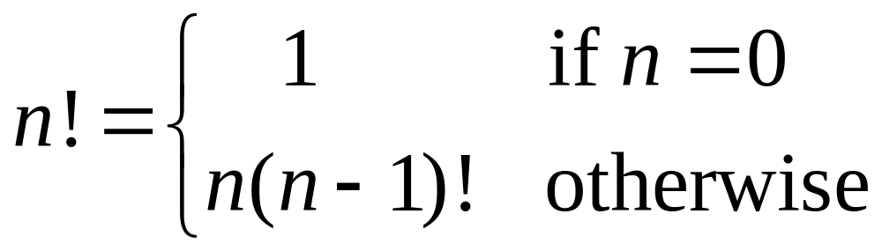
Recursive Definitions
In other words,
Or
This definition says that 0! is 1, while the factorial of any other number is that number times the factorial of one less than that number.

Slide 38
Recursive Definitions
Our definition is recursive, but definitely not circular. Consider 4!
  4! = 4(4-1)! = 4(3!)
  What is 3!? We apply the definition again
  4! = 4(3!) = 4[3(3-1)!] = 4(3)(2!)
  And so on…
  4! = 4(3!) = 4(3)(2!) = 4(3)(2)(1!) = 4(3)(2)(1)(0!) = 4(3)(2)(1)(1) = 24

Slide 39
Recursive Definitions
Factorial is not circular because we eventually get to 0!, whose definition does not rely on the definition of factorial and is just 1. This is called a base case for the recursion.
When the base case is encountered, we get a closed expression that can be directly computed.

Slide 40
Recursive Definitions
All good recursive definitions have these two key characteristics:
  There are one or more base cases for which no recursion is applied.
  All chains of recursion eventually end up at one of the base cases.
The simplest way for these two conditions to occur is for each recursion to act on a smaller version of the original problem. A very small version of the original problem that can be solved without recursion becomes the base case.

Slide 41
Recursive Functions
We’ve seen previously that factorial can be calculated using a loop accumulator.
If factorial is written as a separate function:
def fact(n):
if n == 0:
return 1
else:
return n * fact(n-1)

Slide 42
Recursive Functions
We’ve written a function that calls itself, a recursive function.
The function first checks to see if we’re at the base case (n==0). If so, return 1. Otherwise, return the result of multiplying n by the factorial of n-1, fact(n-1).

Slide 43
Recursive Functions
>>> fact(4)
24
>>> fact(10)
3628800
>>> fact(100)
93326215443944152681699238856266700490715968264381621468592963895217599993229915608941463976156518286253697920827223758251185210916864000000000000000000000000L
>>>
Remember that each call to a function starts that function anew, with its own copies of local variables and parameters.

Slide 44
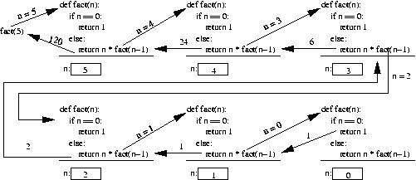
Recursive Functions

Slide 45
Example: String Reversal
Python lists have a built-in method that can be used to reverse the list. What if you wanted to reverse a string?
If you wanted to program this yourself, one way to do it would be to convert the string into a list of characters, reverse the list, and then convert it back into a string.

Slide 46
Example: String Reversal
Using recursion, we can calculate the reverse of a string without the intermediate list step.
Think of a string as a recursive object:
  Divide it up into a first character and “all the rest”
  Reverse the “rest” and append the first character to the end of it

Slide 47
Example: String Reversal
def reverse(s):
return reverse(s[1:]) + s[0]
The slice s[1:] returns all but the first character of the string.
We reverse this slice and then concatenate the first character (s[0]) onto the end.

Slide 48
Example: String Reversal
>>> reverse("Hello")
Traceback (most recent call last):
File "<pyshell#6>", line 1, in -toplevel-
reverse("Hello")
File "C:/Program Files/Python 2.3.3/z.py", line 8, in reverse
return reverse(s[1:]) + s[0]
File "C:/Program Files/Python 2.3.3/z.py", line 8, in reverse
return reverse(s[1:]) + s[0]
…
File "C:/Program Files/Python 2.3.3/z.py", line 8, in reverse
return reverse(s[1:]) + s[0]
RuntimeError: maximum recursion depth exceeded
What happened? There were 1000 lines of errors!

Slide 49
Example: String Reversal
Remember: To build a correct recursive function, we need a base case that doesn’t use recursion.
We forgot to include a base case, so our program is an infinite recursion. Each call to reverse contains another call to reverse, so none of them return.

Slide 50
Example: String Reversal
Each time a function is called it takes some memory. Python stops it at 1000 calls, the default “maximum recursion depth.”
What should we use for our base case?
Following our algorithm, we know we will eventually try to reverse the empty string. Since the empty string is its own reverse, we can use it as the base case.

Slide 51
Example: String Reversal
def reverse(s):
if s == "":
return s
else:
return reverse(s[1:]) + s[0]
>>> reverse("Hello")
'olleH'

Slide 52
Example: Anagrams
An anagram is formed by rearranging the letters of a word.
Anagram formation is a special case of generating all permutations (rearrangements) of a sequence, a problem that is seen frequently in mathematics and computer science.

Slide 53
Example: Anagrams
Let’s apply the same approach from the previous example.
  Slice the first character off the string.
  Place the first character in all possible locations within the anagrams formed from the “rest” of the original string.

Slide 54
Example: Anagrams
Suppose the original string is “abc”. Stripping off the “a” leaves us with “bc”.
Generating all anagrams of “bc” gives us “bc” and “cb”.
To form the anagram of the original string, we place “a” in all possible locations within these two smaller anagrams: [“abc”, “bac”, “bca”, “acb”, “cab”, “cba”]

Slide 55
Example: Anagrams
As in the previous example, we can use the empty string as our base case.
def anagrams(s):
if s == "":
return [s]
else:
ans = []
for w in anagrams(s[1:]):
for pos in range(len(w)+1):
ans.append(w[:pos]+s[0]+w[pos:])
return ans

Slide 56
Example: Anagrams
A list is used to accumulate results.
The outer for loop iterates through each anagram of the tail of s.
The inner loop goes through each position in the anagram and creates a new string with the original first character inserted into that position.
The inner loop goes up to len(w)+1 so the new character can be added at the end of the anagram.

Slide 57
Example: Anagrams
w[:pos]+s[0]+w[pos:]
  w[:pos] gives the part of w up to, but not including, pos.
  w[pos:] gives everything from pos to the end.
  Inserting s[0] between them effectively inserts it into w at pos.

Slide 58
Example: Anagrams
The number of anagrams of a word is the factorial of the length of the word.
>>> anagrams("abc")
['abc', 'bac', 'bca', 'acb', 'cab', 'cba']

Slide 59
Example: Fast Exponentiation
One way to compute a^{n} for an integer n is to multiply a by itself n times.
This can be done with a simple accumulator loop:
def loopPower(a, n):
ans = 1
for i in range(n):
ans = ans * a
return ans

Slide 60
Example: Fast Exponentiation
We can also solve this problem using divide and conquer.
Using the laws of exponents, we know that 2⁸ = 2⁴(2⁴). If we know 2⁴, we can calculate 2⁸ using one multiplication.
What’s 2⁴? 2⁴ = 2²(2²), and 2² = 2(2).
2(2) = 4, 4(4) = 16, 16(16) = 256 = 2⁸
We’ve calculated 2⁸ using only three multiplications!

Slide 61
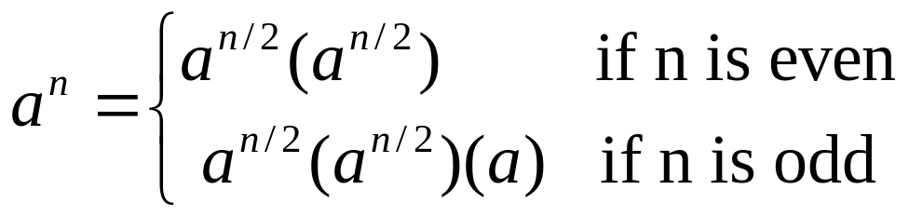
Example: Fast Exponentiation
We can take advantage of the fact that a^{n} = a^{n/2}(a^{n/2})
This algorithm only works when n is even. How can we extend it to work when n is odd?
2⁹ = 2⁴(2⁴)(2¹)

Slide 62
Example: Fast Exponentiation
This method relies on integer division (if n is 9, then n/2 = 4).
To express this algorithm recursively, we need a suitable base case.
If we keep using smaller and smaller values for n, n will eventually be equal to 0 (1/2 = 0 in integer division), and a⁰ = 1 for any value except a = 0.

Slide 63
Example: Fast Exponentiation
def recPower(a, n):
# raises a to the int power n
if n == 0:
return 1
else:
factor = recPower(a, n/2)
if n%2 == 0: # n is even
return factor * factor
else: # n is odd
return factor * factor * a
Here, a temporary variable called factor is introduced so that we don’t need to calculate a^{n/2} more than once, simply for efficiency.

Slide 64
Example: Binary Search
Now that you’ve seen some recursion examples, you’re ready to look at doing binary searches recursively.
Remember: we look at the middle value first, then we either search the lower half or upper half of the array.
The base cases are when we can stop searching,namely, when the target is found or when we’ve run out of places to look.

Slide 65
Example: Binary Search
The recursive calls will cut the search in half each time by specifying the range of locations that are “still in play”, i.e. have not been searched and may contain the target value.
Each invocation of the search routine will search the list between the given low and high parameters.

Slide 66
Example: Binary Search
def recBinSearch(x, nums, low, high):
if low > high: # No place left to look, return -1
return -1
mid = (low + high)/2
item = nums[mid]
if item == x:
return mid
elif x < item: # Look in lower half
return recBinSearch(x, nums, low, mid-1)
else: # Look in upper half
return recBinSearch(x, nums, mid+1, high)
We can then call the binary search with a generic search wrapping function:
def search(x, nums):
return recBinSearch(x, nums, 0, len(nums)-1)

Slide 67
Recursion vs. Iteration
There are similarities between iteration (looping) and recursion.
In fact, anything that can be done with a loop can be done with a simple recursive function! Some programming languages use recursion exclusively.
Some problems that are simple to solve with recursion are quite difficult to solve with loops.

Slide 68
Recursion vs. Iteration
In the factorial and binary search problems, the looping and recursive solutions use roughly the same algorithms, and their efficiency is nearly the same.
In the exponentiation problem, two different algorithms are used. The looping version takes linear time to complete, while the recursive version executes in log time. The difference between them is like the difference between a linear and binary search.

Slide 69
Recursion vs. Iteration
So… will recursive solutions always be as efficient or more efficient than their iterative counterpart?
The Fibonacci sequence is the sequence of numbers 1,1,2,3,5,8,…
  The sequence starts with two 1’s
  Successive numbers are calculated by finding the sum of the previous two

Slide 70
Recursion vs. Iteration
Loop version:
  Let’s use two variables, curr and prev, to calculate the next number in the sequence.
  Once this is done, we set prev equal to curr, and set curr equal to the just-calculated number.
  All we need to do is to put this into a loop to execute the right number of times!

Slide 71
Recursion vs. Iteration
def loopfib(n):
# returns the nth Fibonacci number
curr = 1
prev = 1
for i in range(n-2):
curr, prev = curr+prev, curr
return curr
Note the use of simultaneous assignment to calculate the new values of curr and prev.
The loop executes only n-2 since the first two values have already been “determined”.

Slide 72
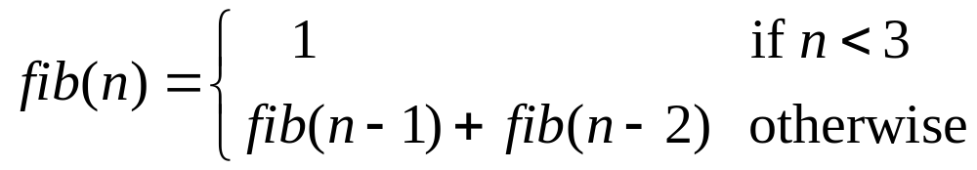
Recursion vs. Iteration
The Fibonacci sequence also has a recursive definition:
This recursive definition can be directly turned into a recursive function!
def fib(n):
if n < 3:
return 1
else:
return fib(n-1)+fib(n-2)

Slide 73
Recursion vs. Iteration
This function obeys the rules that we’ve set out.
  The recursion is always based on smaller values.
  There is a non-recursive base case.
So, this function will work great, won’t it? – Sort of…

Slide 74
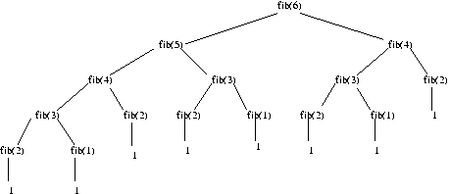
Recursion vs. Iteration
The recursive solution is extremely inefficient, since it performs many duplicate calculations!

Slide 75
Recursion vs. Iteration
To calculate fib(6), fib(4)is calculated twice, fib(3)is calculated three times, fib(2)is calculated four times… For large numbers, this adds up!

Slide 76
Recursion vs. Iteration
Recursion is another tool in your problem-solving toolbox.
Sometimes recursion provides a good solution because it is more elegant or efficient than a looping version.
At other times, when both algorithms are quite similar, the edge goes to the looping solution on the basis of speed.
Avoid the recursive solution if it is terribly inefficient, unless you can’t come up with an iterative solution (which sometimes happens!)

Slide 77
Sorting Algorithms
The basic sorting problem is to take a list and rearrange it so that the values are in increasing (or nondecreasing) order.

Slide 78
Naive Sorting: Selection Sort
To start out, pretend you’re the computer, and you’re given a shuffled stack of index cards, each with a number. How would you put the cards back in order?

Slide 79
Naive Sorting: Selection Sort
One simple method is to look through the deck to find the smallest value and place that value at the front of the stack.
Then go through, find the next smallest number in the remaining cards, place it behind the smallest card at the front.
Rinse, lather, repeat, until the stack is in sorted order!

Slide 80
Naive Sorting: Selection Sort
We already have an algorithm to find the smallest item in a list (Chapter 7). As you go through the list, keep track of the smallest one seen so far, updating it when you find a smaller one.
This sorting algorithm is known as a selection sort.

Slide 81
Naive Sorting: Selection Sort
The algorithm has a loop, and each time through the loop the smallest remaining element is selected and moved into its proper position.
  For n elements, we find the smallest value and put it in the 0th position.
  Then we find the smallest remaining value from position 1 – (n-1) and put it into position 1.
  The smallest value from position 2 – (n-1) goes in position 2.
  Etc.

Slide 82
Naive Sorting: Selection Sort
When we place a value into its proper position, we need to be sure we don’t accidentally lose the value originally stored in that position.
If the smallest item is in position 10, moving it into position 0 involves the assignment: nums[0] = nums[10]
This wipes out the original value in nums[0]!

Slide 83
Naive Sorting: Selection Sort
We can use simultaneous assignment to swap the values between nums[0] and nums[10]:
nums[0],nums[10] = nums[10],nums[0]
Using these ideas, we can implement our algorithm, using variable bottom for the currently filled position, and mp is the location of the smallest remaining value.

Slide 84
Naive Sorting: Selection Sort
def selSort(nums):
# sort nums into ascending order
n = len(nums)
# For each position in the list (except the very last)
for bottom in range(n-1):
# find the smallest item in nums[bottom]..nums[n-1]
mp = bottom # bottom is smallest initially
for i in range(bottom+1, n): # look at each position
if nums[i] < nums[mp]: # this one is smaller
mp = i # remember its index
# swap smallest item to the bottom
nums[bottom], nums[mp] = nums[mp], nums[bottom]

Slide 85
Naive Sorting: Selection Sort
Rather than remembering the minimum value scanned so far, we store its position in the list in the variable mp.
New values are tested by comparing the item in position i with the item in position mp.
bottom stops at the second to last item in the list. Why? Once all items up to the last are in order, the last item must be the largest!

Slide 86
Naive Sorting: Selection Sort
The selection sort is easy to write and works well for moderate-sized lists, but is not terribly efficient. We’ll analyze this algorithm in a little bit.

Slide 87
Divide and Conquer:
Merge Sort
We’ve seen how divide and conquer works in other types of problems. How could we apply it to sorting?
Say you and your friend have a deck of shuffled cards you’d like to sort. Each of you could take half the cards and sort them. Then all you’d need is a way to recombine the two sorted stacks!

Slide 88
Divide and Conquer:
Merge Sort
This process of combining two sorted lists into a single sorted list is called merging.
Our merge sort algorithm looks like:
split nums into two halves
sort the first half
sort the second half
merge the two sorted halves back into nums

Slide 89
Divide and Conquer:
Merge Sort
Step 1: split nums into two halves
  Simple! Just use list slicing!
Step 4: merge the two sorted halves back into nums
  This is simple if you think of how you’d do it yourself…
  You have two sorted stacks, each with the smallest value on top. Whichever of these two is smaller will be the first item in the list.

Slide 90
Divide and Conquer:
Merge Sort
  Once the smaller value is removed, examine both top cards. Whichever is smaller will be the next item in the list.
  Continue this process of placing the smaller of the top two cards until one of the stacks runs out, in which case the list is finished with the cards from the remaining stack.
  In the following code, lst1 and lst2 are the smaller lists and lst3 is the larger list for the results. The length of lst3 must be equal to the sum of the lengths of lst1 and lst2.

Slide 91
Divide and Conquer:
Merge Sort
def merge(lst1, lst2, lst3):
# merge sorted lists lst1 and lst2 into lst3
# these indexes keep track of current position in each list
i1, i2, i3 = 0, 0, 0 # all start at the front
n1, n2 = len(lst1), len(lst2)
# Loop while both lst1 and lst2 have more items
while i1 < n1 and i2 < n2:
if lst1[i1] < lst2[i2]: # top of lst1 is smaller
lst3[i3] = lst1[i1] # copy it into current spot in lst3
i1 = i1 + 1
else: # top of lst2 is smaller
lst3[i3] = lst2[i2] # copy itinto current spot in lst3
i2 = i2 + 1
i3 = i3 + 1 # item added to lst3, update position

Slide 92
Divide and Conquer:
Merge Sort
# Here either lst1 or lst2 is done. One of the following loops
# will execute to finish up the merge.
# Copy remaining items (if any) from lst1
while i1 < n1:
lst3[i3] = lst1[i1]
i1 = i1 + 1
i3 = i3 + 1
# Copy remaining items (if any) from lst2
while i2 < n2:
lst3[i3] = lst2[i2]
i2 = i2 + 1
i3 = i3 + 1

Slide 93
Divide and Conquer:
Merge Sort
We can slice a list in two, and we can merge these new sorted lists back into a single list. How are we going to sort the smaller lists?
We are trying to sort a list, and the algorithm requires two smaller sorted lists… this sounds like a job for recursion!

Slide 94
Divide and Conquer:
Merge Sort
We need to find at least one base case that does not require a recursive call, and we also need to ensure that recursive calls are always made on smaller versions of the original problem.
For the latter, we know this is true since each time we are working on halves of the previous list.

Slide 95
Divide and Conquer:
Merge Sort
Eventually, the lists will be halved into lists with a single element each. What do we know about a list with a single item?
It’s already sorted!! We have our base case!
When the length of the list is less than 2, we do nothing.
We update the mergeSort algorithm to make it properly recursive…

Slide 96
Divide and Conquer:
Merge Sort
if len(nums) > 1:
split nums into two halves
mergeSort the first half
mergeSort the seoncd half
mergeSort the second half
merge the two sorted halves back into nums

Slide 97
Divide and Conquer:
Merge Sort
def mergeSort(nums):
# Put items of nums into ascending order
n = len(nums)
# Do nothing if nums contains 0 or 1 items
if n > 1:
# split the two sublists
m = n/2
nums1, nums2 = nums[:m], nums[m:]
# recursively sort each piece
mergeSort(nums1)
mergeSort(nums2)
# merge the sorted pieces back into original list
merge(nums1, nums2, nums)

Slide 98
Divide and Conquer:
Merge Sort
Recursion is closely related to the idea of mathematical induction, and it requires practice before it becomes comfortable.
Follow the rules and make sure the recursive chain of calls reaches a base case, and your algorithms will work!

Slide 99
Comparing Sorts
We now have two sorting algorithms. Which one should we use?
The difficulty of sorting a list depends on the size of the list. We need to figure out how many steps each of our sorting algorithms requires as a function of the size of the list to be sorted.

Slide 100
Comparing Sorts
Let’s start with selection sort.
In this algorithm we start by finding the smallest item, then finding the smallest of the remaining items, and so on.
Suppose we start with a list of size n. To find the smallest element, the algorithm inspects all n items. The next time through the loop, it inspects the remaining n-1 items. The total number of iterations is:
n + (n-1) + (n-2) + (n-3) + … + 1

Slide 101

Comparing Sorts
The time required by selection sort to sort a list of n items is proportional to the sum of the first n whole numbers, or .
This formula contains an n² term, meaning that the number of steps in the algorithm is proportional to the square of the size of the list.

Slide 102
Comparing Sorts
If the size of a list doubles, it will take four times as long to sort. Tripling the size will take nine times longer to sort!
Computer scientists call this a quadratic or n² algorithm.

Slide 103
Comparing Sorts
In the case of the merge sort, a list is divided into two pieces and each piece is sorted before merging them back together. The real place where the sorting occurs is in the merge function.

Slide 104
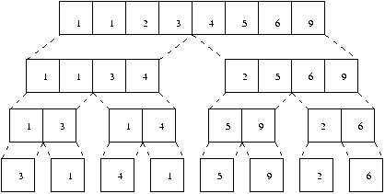
Comparing Sorts
This diagram shows how [3,1,4,1,5,9,2,6] is sorted.
Starting at the bottom, we have to copy the n values into the second level.

Slide 105
Comparing Sorts
From the second to third levels the n values need to be copied again.
Each level of merging involves copying n values. The only remaining question is how many levels are there?

Slide 106
Comparing Sorts
We know from the analysis of binary search that this is just log₂n.
Therefore, the total work required to sort n items is nlog₂n.
Computer scientists call this an n log n algorithm.

Slide 107
Comparing Sorts
So, which is going to be better, the n² selection sort, or the n logn merge sort?
If the input size is small, the selection sort might be a little faster because the code is simpler and there is less overhead.
What happens as n gets large? We saw in our discussion of binary search that the log function grows very slowly, so nlogn will grow much slower than n².

Slide 108
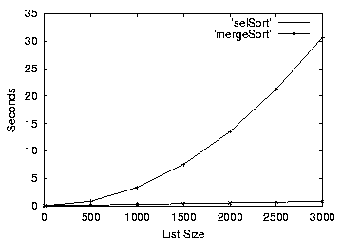
Comparing Sorts

Slide 109
Hard Problems
Using divide-and-conquer we could design efficient algorithms for searching and sorting problems.
Divide and conquer and recursion are very powerful techniques for algorithm design.
Not all problems have efficient solutions!

Slide 110
Towers of Hanoi
One elegant application of recursion is to the Towers of Hanoi or Towers of Brahma puzzle attributed to Édouard Lucas.
There are three posts and sixty-four concentric disks shaped like a pyramid.
The goal is to move the disks from one post to another, following these three rules:

Slide 111
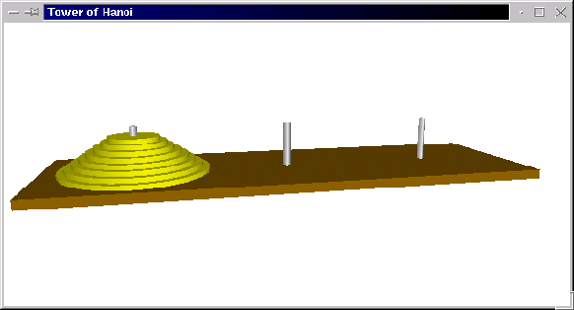
Towers of Hanoi
  Only one disk may be moved at a time.
  A disk may not be “set aside”. It may only be stacked on one of the three posts.
  A larger disk may never be placed on top of a smaller one.

Slide 112
Towers of Hanoi
If we label the posts as A, B, and C, we could express an algorithm to move a pile of disks from A to C, using B as temporary storage, as:
Move disk from A to C
Move disk from A to B
Move disk from C to B

Slide 113
Towers of Hanoi
Let’s consider some easy cases –
  1 disk
  Move disk from A to C
  2 disks
  Move disk from A to B
  Move disk from A to C
  Move disk from B to C

Slide 114
Towers of Hanoi
  3 disks
  To move the largest disk to C, we first need to move the two smaller disks out of the way. These two smaller disks form a pyramid of size 2, which we know how to solve.
  Move a tower of two from A to B
  Move one disk from A to C
  Move a tower of two from B to C

Slide 115
Towers of Hanoi
Algorithm: move n-disk tower from source to destination via resting place
move n-1 disk tower from source to resting place
move 1 disk tower from source to destination
move n-1 disk tower from resting place to destination
What should the base case be? Eventually we will be moving a tower of size 1, which can be moved directly without needing a recursive call.

Slide 116
Towers of Hanoi
In moveTower, n is the size of the tower (integer), and source, dest, and temp are the three posts, represented by “A”, “B”, and “C”.
def moveTower(n, source, dest, temp):
if n == 1:
print "Move disk from", source, "to", dest+".“
else:
moveTower(n-1, source, temp, dest)
moveTower(1, source, dest, temp)
moveTower(n-1, temp, dest, source)

Slide 117
Towers of Hanoi
To get things started, we need to supply parameters for the four parameters:
def hanoi(n):
moveTower(n, "A", "C", "B")
>>> hanoi(3)
Move disk from A to C.
Move disk from A to B.
Move disk from C to B.
Move disk from A to C.
Move disk from B to A.
Move disk from B to C.
Move disk from A to C.

Slide 118
Towers of Hanoi
Why is this a “hard problem”?
How many steps in our program are required to move a tower of size n?
Number of Disks | Steps in Solution
1 | 1
2 | 3
3 | 7
4 | 15
5 | 31

Slide 119
Towers of Hanoi
To solve a puzzle of size n will require 2^{n}-1 steps.
Computer scientists refer to this as an exponential time algorithm.
Exponential algorithms grow very fast.
For 64 disks, moving one a second, round the clock, would require 580 billion years to complete. The current age of the universe is estimated to be about 15 billion years.

Slide 120
Towers of Hanoi
Even though the algorithm for Towers of Hanoi is easy to express, it belongs to a class of problems known as intractable problems – those that require too many computing resources (either time or memory) to be solved except for the simplest of cases.
There are problems that are even harder than the class of intractable problems.

Slide 121
The Halting Problem
Let’s say you want to write a program that looks at other programs to determine whether they have an infinite loop or not.
We’ll assume that we need to also know the input to be given to the program in order to make sure it’s not some combination of input and the program itself that causes it to infinitely loop.

Slide 122
The Halting Problem
Program Specification:
  Program: Halting Analyzer
  Inputs: A Python program file. The input for the program.
  Outputs: “OK” if the program will eventually stop. “FAULTY” if the program has an infinite loop.
You’ve seen programs that look at programs before – like the Python interpreter!
The program and its inputs can both be represented by strings.

Slide 123
The Halting Problem
There is no possible algorithm that can meet this specification!
This is different than saying no one’s been able to write such a program… we can prove that this is the case using a mathematical technique known as proof by contradiction.

Slide 124
The Halting Problem
To do a proof by contradiction, we assume the opposite of what we’re trying to prove, and show this leads to a contradiction.
First, let’s assume there is an algorithm that can determine if a program terminates for a particular set of inputs. If it does, we could put it in a function:

Slide 125
The Halting Problem
def terminates(program, inputData):
# program and inputData are both strings
# Returns true if program would halt when run
# with inputData as its input
If we had a function like this, we could write the following program:
# turing.py
import string
def terminates(program, inputData):
# program and inputData are both strings
# Returns true if program would halt when run
# with inputData as its input

Slide 126
The Halting Problem
def main():
# Read a program from standard input
lines = []
print "Type in a program (type 'done' to quit)."
line = raw_input("")
while line != "done":
lines.append(line)
line = raw_input("")
testProg = string.join(lines, "\n")
# If program halts on itself as input, go into
# an inifinite loop
if terminates(testProg, testProg):
while True:
pass # a pass statement does nothing

Slide 127
The Halting Problem
The program is called “turing.py” in honor of Alan Turing, the British mathematician who is considered to be the “father of Computer Science”.
Let’s look at the program step-by-step to see what it does…

Slide 128
The Halting Problem
turing.py first reads in a program typed by the user, using a sentinel loop.
The string.join function then concatenates the accumulated lines together, putting a newline (\n) character between them.
This creates a multi-line string representing the program that was entered.

Slide 129
The Halting Problem
turing.py next uses this program as not only the program to test, but also as the input to test.
In other words, we’re seeing if the program you typed in terminates when given itself as input.
If the input program terminates, the turing program will go into an infinite loop.

Slide 130
The Halting Problem
This was all just a set-up for the big question: What happens when we run turing.py, and use turing.py as the input?
Does turing.py halt when given itself as input?

Slide 131
The Halting Problem
In the terminates function, turing.py will be evaluated to see if it halts or not.
We have two possible cases:
  turing.py halts when given itself as input
    Terminates returns true
    So, turing.py goes into an infinite loop
    Therefore turing.py doesn’t halt, a contradiction

Slide 132
The Halting Problem
  Turing.py does not halt
    terminates returns false
    When terminates returns false, the program quits
    When the program quits, it has halted, a contradiction
The existence of the function terminates would lead to a logical impossibility, so we can conclude that no such function exists.

Slide 133
Conclusion
Computer Science is more than programming!
The most important computer for any computing professional is between their ears.

